Slide 1
Aneuploidies and mutations in chromatin modifier genes
2021-03-03
Luan Nguyen

Slide 2
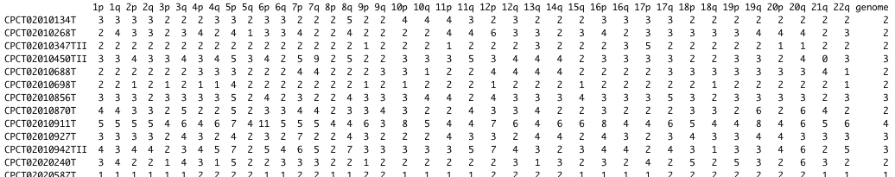
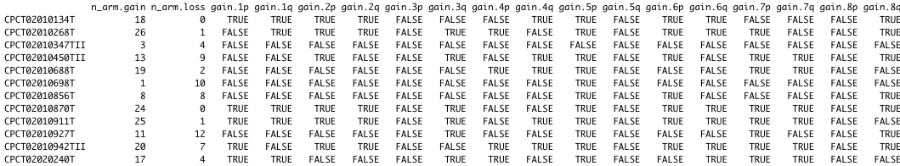
Input features
Chrom arm and genome copy number
Number of arm gains/losses
Which arms have CN gain/loss vs. genome copy number
← Input for enrichment analysis

Slide 3
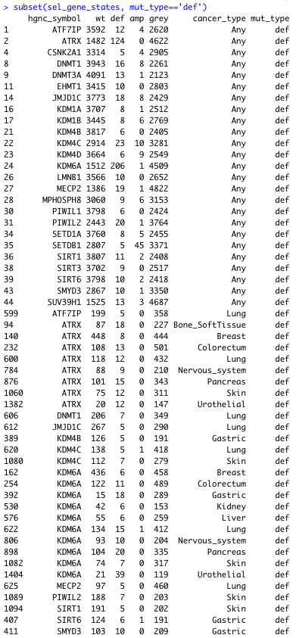
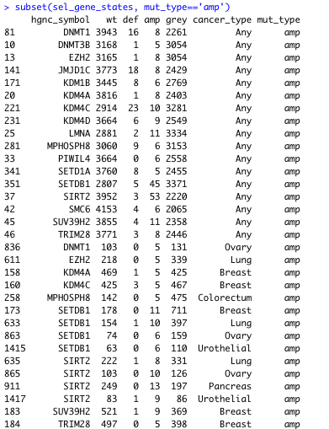
Compare samples with WT vs mutated genes
Require ≥5 mutated samples and ≥5 WT samples
Deficiences
(biallelic loss)
Focal amplifications
(gene CN ≥4x genome CN)

Slide 4
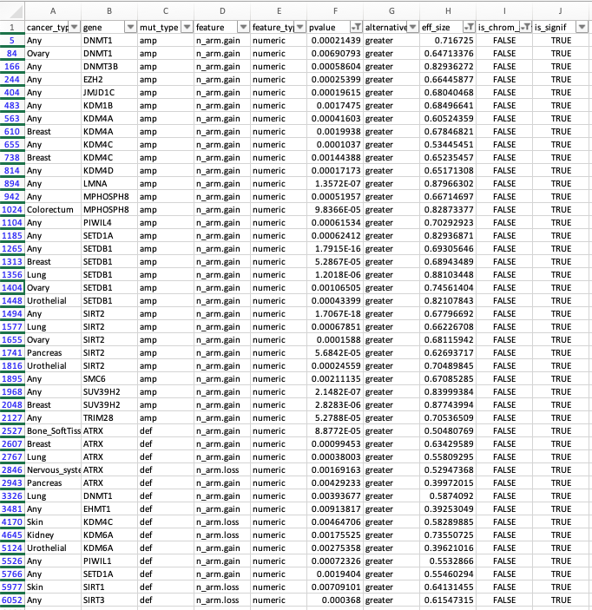
Enrichment: number of arm gains/losses
Significant: p<0.01, effect size>=0.3
Focal amplifications of many genes all lead to more arm gains and this is a bit suspicious
I suspect that this is some sort of technical artefact, but I can’t really pinpoint what
Alternatively, it’d could be that here we are just seeing tumors with a lot of focal amplifications, so amplification of the gene of interest is just a passenger event
However… SIRT2 and SETDB1 amplifications are also associated with high LINE counts (see next section)
With 2 pieces of evidence, this observation may be biologically meaningful
ATRX deficiency leads to arm gains, but also losses (← this gives us more confidence that this observation is not due to technical artefacting as I mentioned above)
Also, since we see this in multiple cancer types, this observation is more likely to be true
Details on next slide

Slide 5
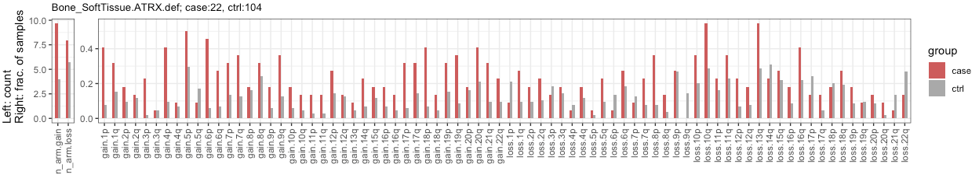
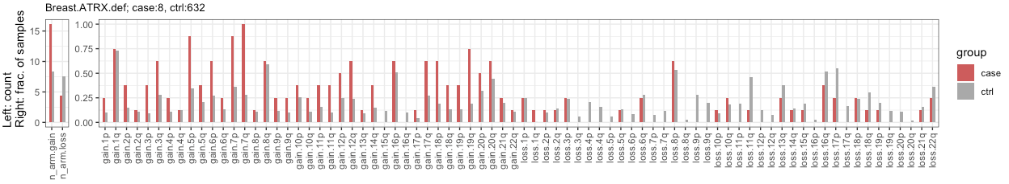
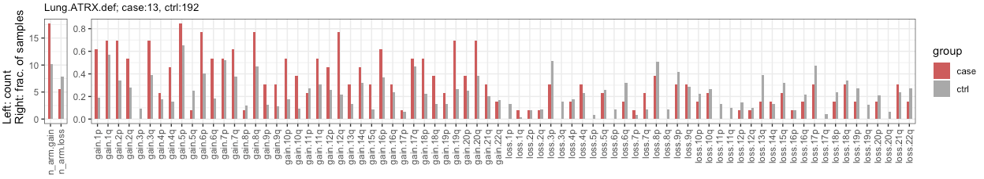
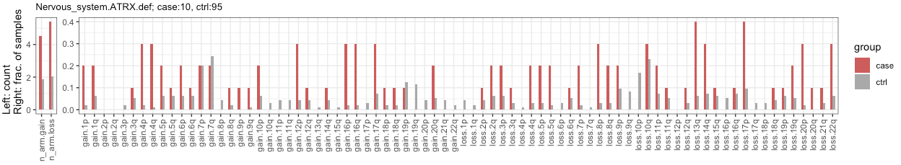
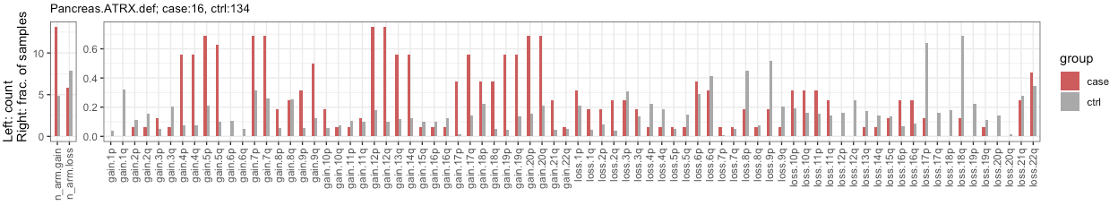
Both gains and losses
Only gains
Only gains
Both gains and losses
Only gains

Slide 6
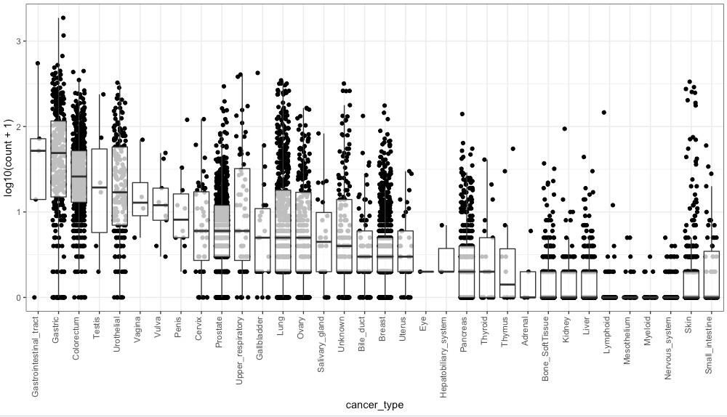
Definition of ‘high rate of LINEs’
LINEs known to be enriched in gastric and colorectal cancer
1st quartile @ approx. 10 LINE events
I therefore mark samples as having:
High LINE events (case): >=10 LINE events
Low LINE events (ctrl): <10
I then try to find which gene mutations are enriched in the ‘High LINE’ vs. ‘Low LINE’ samples. I also repeat this enrichment analysis by cancer type

Slide 7
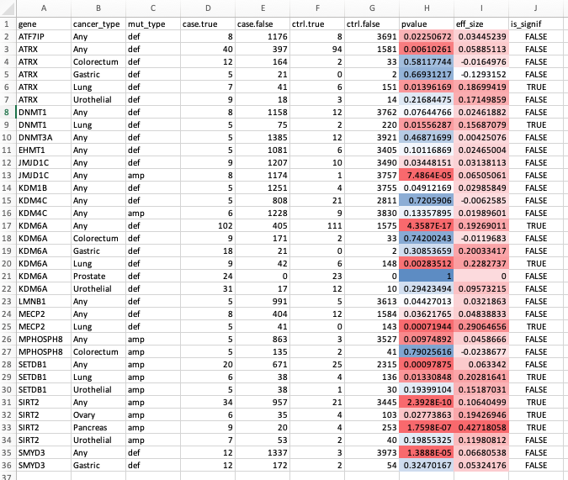
Gene mutation enrichment
case.true = High LINE samples with indicated gene mutation
ctrl.true = Low LINE samples with indicated gene mutation
Significant: p<0.05, effect size>=0.1
High LINE samples are enriched in ATRX deficiency, but the effect size is very small (0.059)
Upon careful inspection, this enrichment is likely specific to Lung cancer
High LINE samples are enriched in KDM6A deficiency
Again, enrichment is likely specific to Lung cancer
…similarly for SIRT2 and SETDB1 amplification

Slide 8
Summary
ATRX deficiency
Weakly associated with chrom arm aneuploidy
Weakly enriched in LINE high samples
SIRT2 and SETDB1 amplifications
Potentially associated with chrom arm gains
Enriched in LINE high samples

